Slide 1
John Maland High School
Welcome Families

Slide 2
Meet Our Staff
Darren Caldwell – Principal
Jill Mattock – Assistant Principal, Physics and CALM
Crissi Fedor – Athletic Director, Physical Education, and CALM
Clarence Samuelson – Stage Band, Concert Band, and Jazz Ensemble
Keri Helgren – English and Students Services
Mike Breker – Sports Medicine, Outdoor Education, and Social Studies
Lucia Kruyer – Cosmetology, Drama and Student Services
Sean Edmondson – Construction, Design Studies, and Communications Technology
Leanne Mistol – Food Studies

Slide 3
Meet Our Staff
Don Finlayson – Mathematics and CTS
Anita Filice – Mathematics and Science
Cliff Courchene – Biology, Chemistry, Science, and Mathematics
Nicole Harrish – English and Social Studies
Kim Edmondson – Social Studies and English
Katie Hiller – Biology, Chemistry, and Science
Laurelle Loe – Social Studies and English
Paula Smith – Mathematics and Northern Alberta Xtreme

Slide 4
Meet Our Staff
Jennifer Burgess – Head Secretary
Joelene Peterson – Secretary
Lee Melnyk – Librarian
Melanie Samuelson – Educational Assistant (Music)
Karlene Saville – Educational Assistant (Academic)
Leia Burgess – Library Clerk
Ann-Marie Downer - Custodian
Michel Foisey - Custodian

Slide 5
Option Course Offerings

Slide 6
JMHS Option Offerings
Fine Arts
CTS
Off Campus Ed
Art
Drama
Musical Theatre
Instrumental Music
General Music
Jazz Ensemble
Outdoor Education
Cosmetology
Communication Technologies
Design Studies
Construction Technologies
Food Sciences
Sports Medicine
Work Experience
RAP Program
Green Certificate

Slide 7
Core Course Sequences

Slide 8
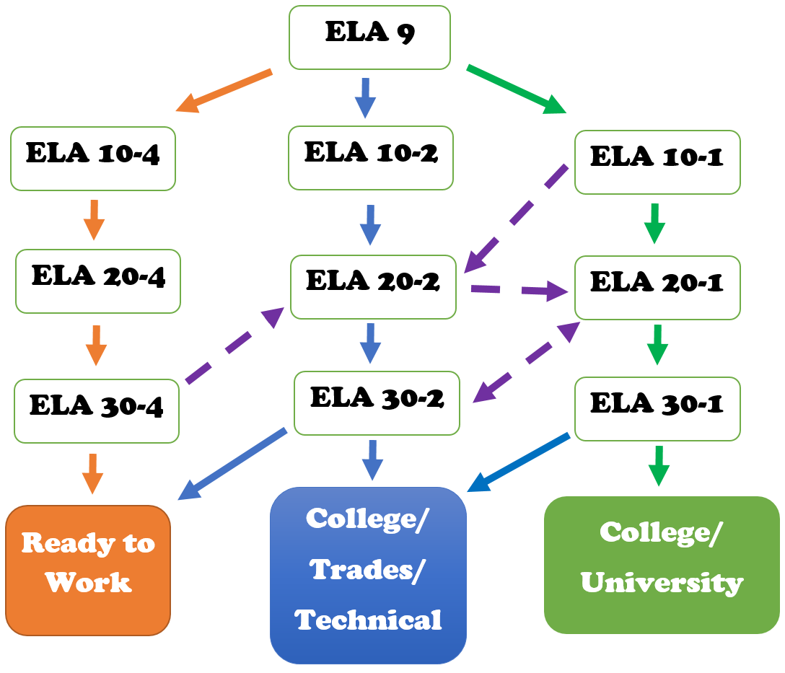
English Language Arts

Slide 9
Considerations for Course Selection: English Language Arts
What English (ELA) stream should I take?
To be successful in ELA 10-1, a mark of 65% or better in ELA 9
This course is designed to challenge students’ analytical reading and writing skills in new ways, with a focus on preparation for university
Any mark under 50% - it is strongly recommended that the student enroll in ELA 10-2
This course is designed to reinforce and build ELA skills, with a focus on functional reading and writing skills, in preparation for college diploma programs and the trades
Students currently enrolled in K&E Language Arts 9, with marks 60% or higher, may achieve success in ELA 10-2
Students with marks in K&E Language Arts 9 lower than 40% - it is recommended that they continue in the K&E course sequence (ELA 10-4)

Slide 10
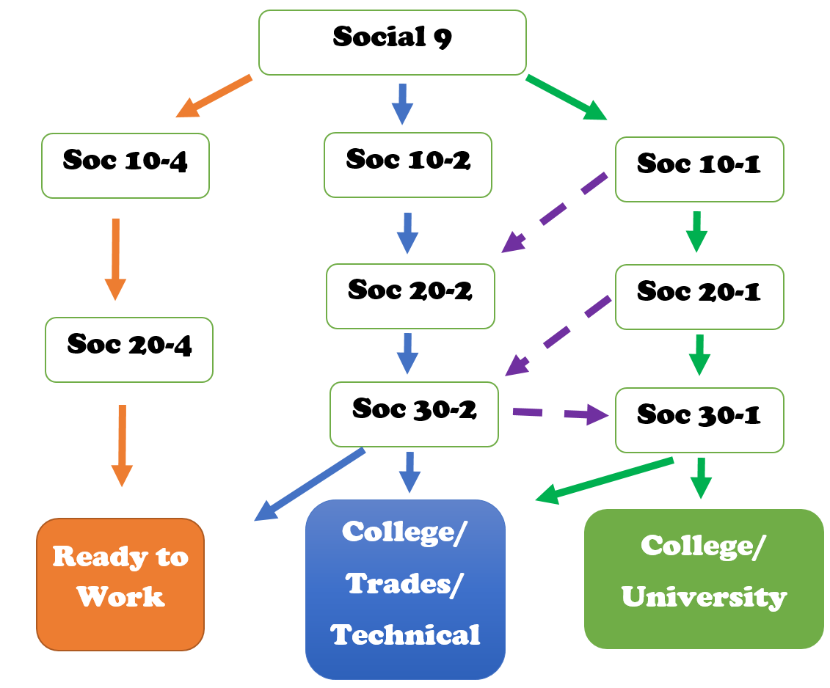
Social Studies

Slide 11
Considerations for Course Selection: Social Studies
What Social Studies stream should I take?
Social Studies 10-1 is recommended for the university entry pathway
To be successful in Social Studies 10-1, we recommend a mark of 65% or higher in Social Studies 9
Social Studies 10-1 demands more independent reading and writing than Social 9 and Social 10-2
A mark below 65% in Social Studies 9 and a desire to pursue trades or college would benefit from Social 10-2

Slide 12
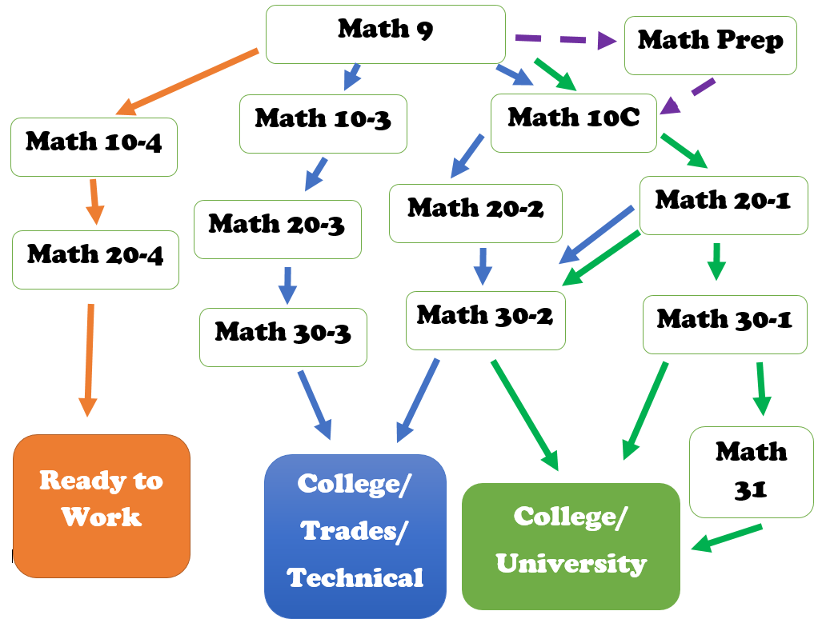
Mathematics

Slide 13
Considerations for Course Selection: Mathematics
What Math stream should I take?
To be successful in Math 10C, a mark of 65% or better in Math 9
Any mark between 45% and 64% and a desire to go to University would benefit from enrolling in Math 10 Prep
This is a 5 credit course that offers an opportunity to build a stronger foundation of needed math skills before going into Math 10C
Any mark below 65% and a desire to go into College or Trades would benefit from Math 10-3

Slide 14
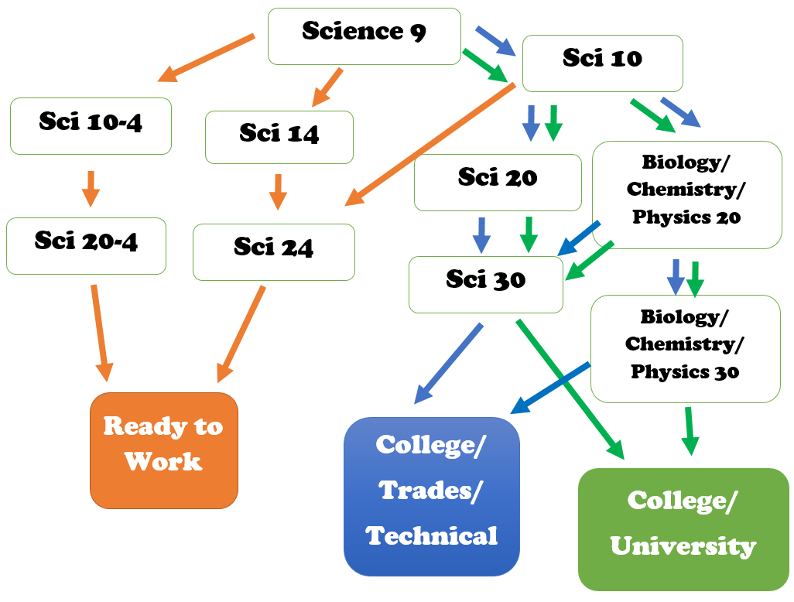
Sciences

Slide 15
Considerations for Course Selection: Sciences
What Science stream should I take?
To be successful in Science 10
with the intent to study the focused sciences at the 20 and 30 level, a mark of 65% or better in Science 9 is needed, and a mark of 70% or better is needed at the end of Science 10.
With the intent to study general science 20 and 30, a mark of 50% - 65% is needed in Science 9.
Any mark below 50% coming out of Science 9 the required course selection is Science 14.

Slide 16
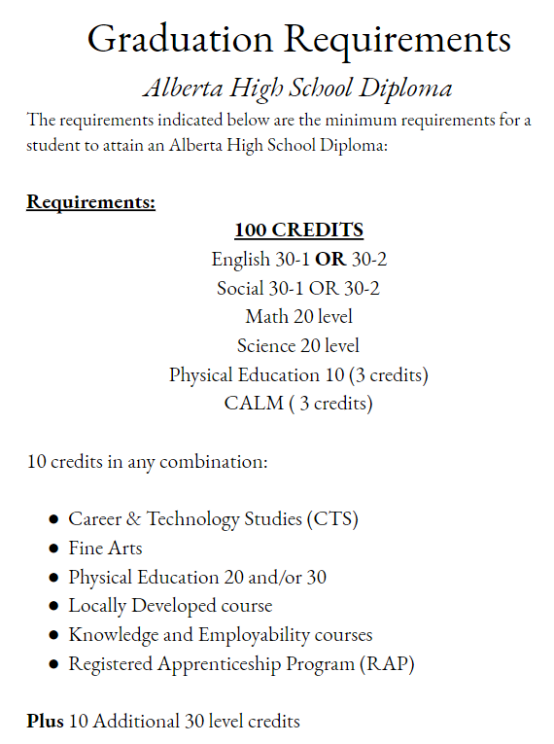
What is needed to Graduate?

Slide 17
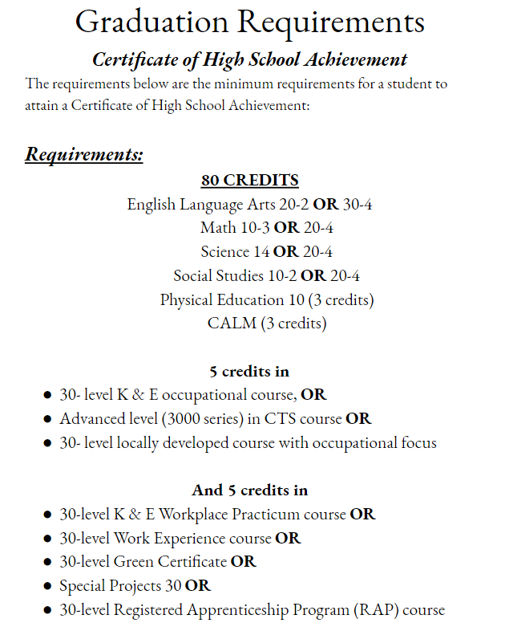
What is needed to Graduate?

Slide 18
Transition to High School – What to Know
It is natural for your first semester average to drop from your grade 9 average by 10%-15%. It does recover with organization, time management, hard work and communication with teachers.
Classes are 85 minutes long
Being semestered means the pace of instruction is faster.
Asking your teachers questions is very important before you move on to the next topic. It is essential that you do not get behind in your classes.

Slide 19
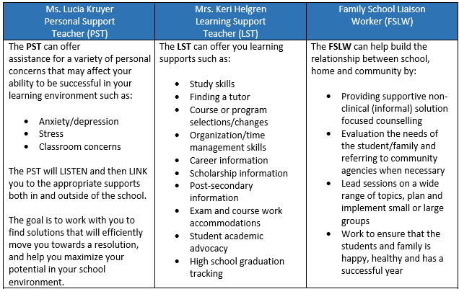
How JMHS Staff Supports Your Child

Slide 20
Now What?
Parents, your child does not need to know what they want to be before they start grade 10.
Students, hopefully you know what you do not want to be 😊
Ask yourself:
What are my strengths?
Where am I most suited NOW?
Remember we are building to the 30 level. This may mean an alternate pathway to get there….be open for paths to success.

